Slide 1
Study and Control of Biped Robot using Intelligent Control
By- Aayushi Shrivastava (15115002)
Project supervisor : Prof. M. Felix Orlando
Dr. M. M. Joglekar

Slide 2
Objectives
To make a testbed biped robot that is bound to move in sagittal plane by giving a support in frontal plane and implement a intelligent controller and test the efficiency of that controller.

Slide 3
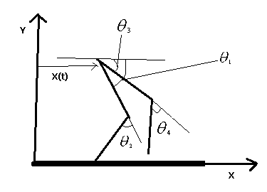
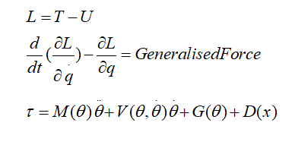
Dynamic modelling of robot
Our robot is 5 DOF robot and has 4 actuators so it is underactuated.
We derived the equations of motion of the robot using lagrangian dynamics.

Slide 4
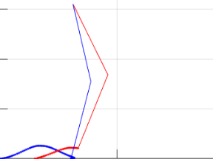
Dynamic modelling of robot
We derived the solution of these equations or periodic orbits by assuming legs to be in two phases:
Stance Phase : found trajectory (variation of theta) by assuming it as a linear pendulum.
Swing phase : found trajectory by assuming a theta varying as a quintic (5 degree ) polynomial function of time.
Swing leg
Stance leg

Slide 5
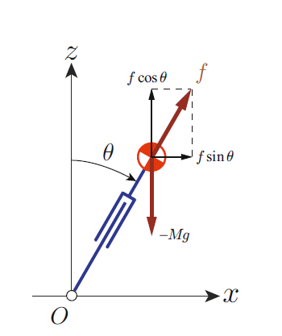
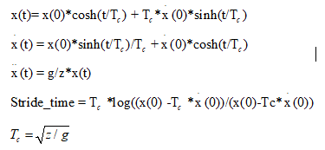
Stance Phase model
Modelled as linear inverted pendulum
The assumed COM moves in straight line
Following trajectory of ‘x’ of COM comes:

Slide 6
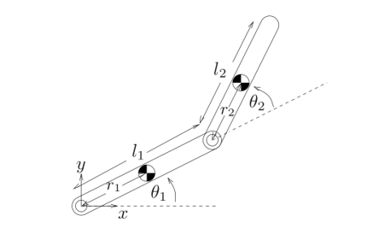

Swing Leg model
The swing leg is modelled as 2 DOF manipulator with respect to the hip joint.
The joint angles vary by a quintic (5 degree) equation wrt time, with some given initial and final conditions.
These initial and final conditions ensure that the joint acceleration remain continuous and there are no jerks in the system.

Slide 7
Designing the controller and Simulation
Designing the controller:
We are using feedback linearization or control law partitioning based PD controller.
As our system is system is underactuated hence we are assuming the x-coordinate of the robot to follow the desired trajectory.(in place of its feedback)

Slide 8
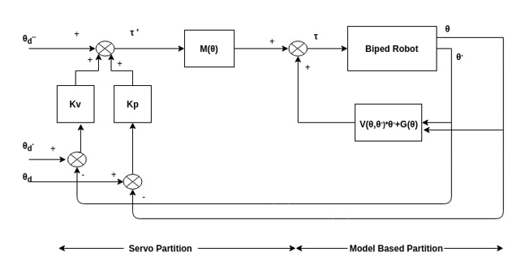
Controller Block Diagram

Slide 9
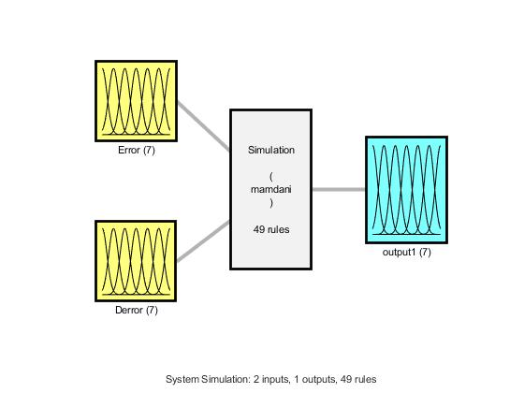
Fuzzy Inference System

Slide 10
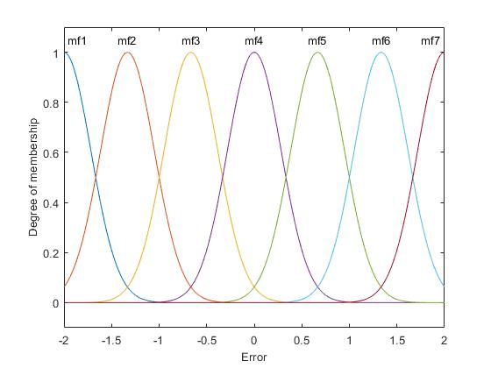
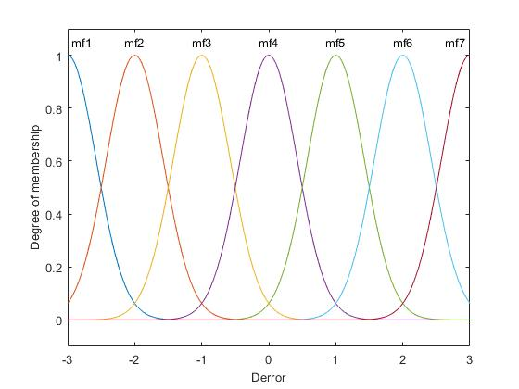
Input membership functions

Slide 11
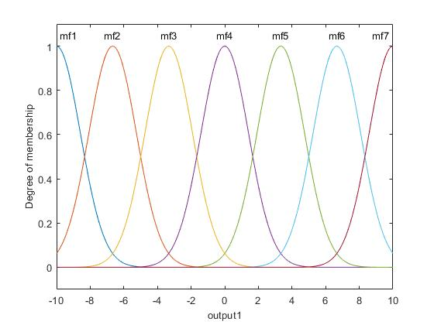
Output Membership Functions

Slide 12
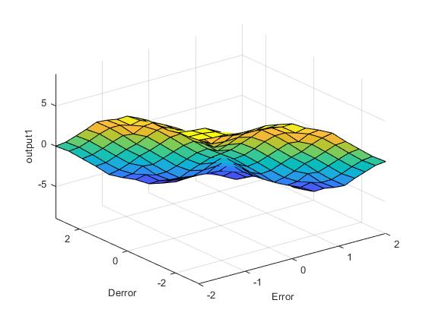
Surface of Fuzzy Inference system

Slide 13
Designing the controller and Simulation
Simulation:
Simulation in matlab:

Slide 14
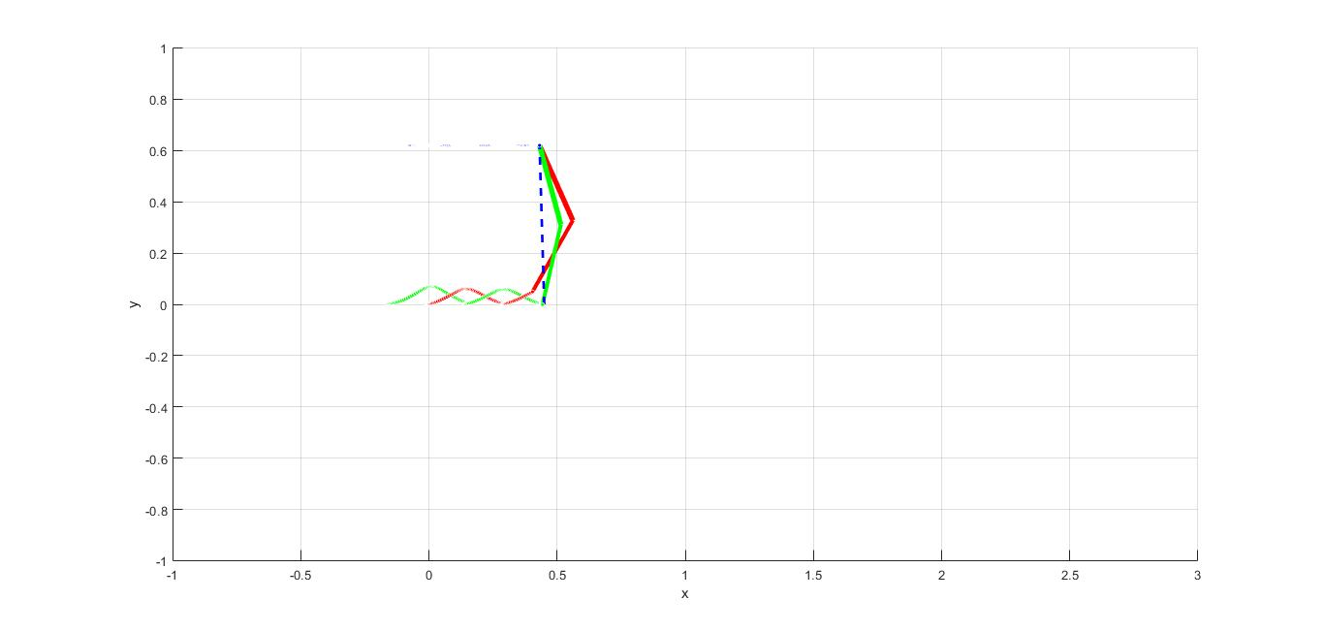
Simulation Results

Slide 15
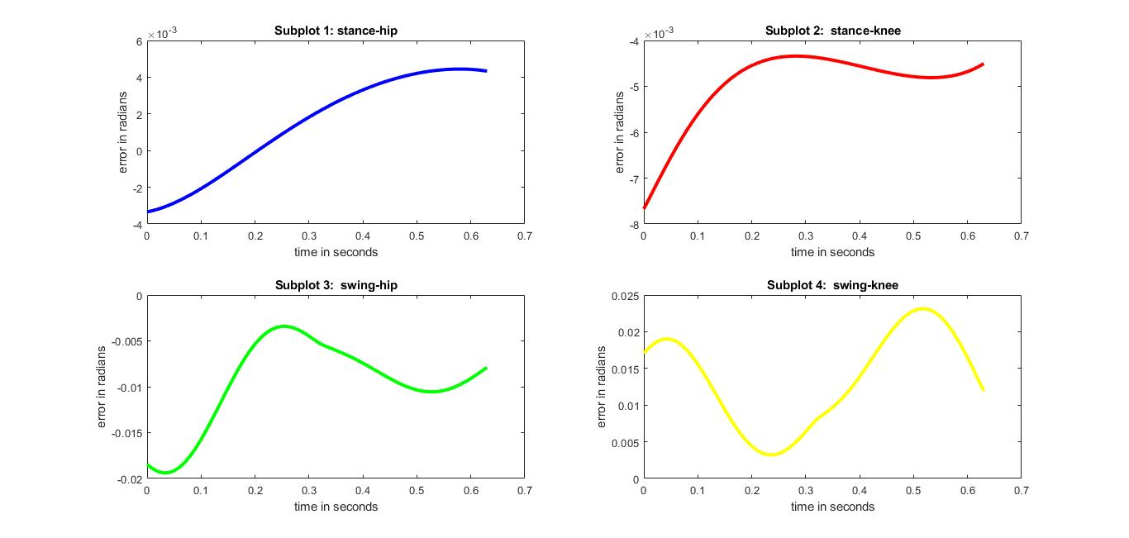
Error as a function of time

Slide 16
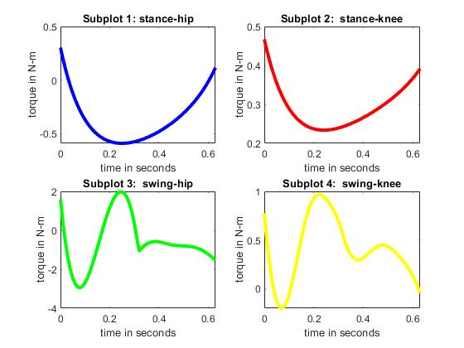
Actuator torques as function of time

Slide 17
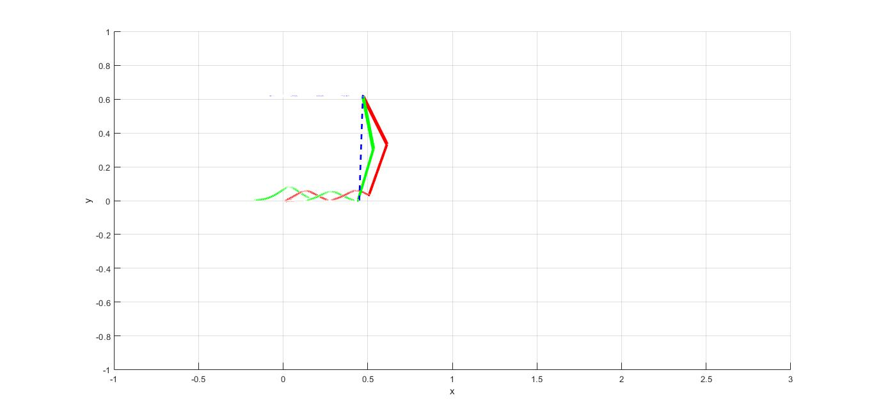
Simulation Results -Fuzzy

Slide 18
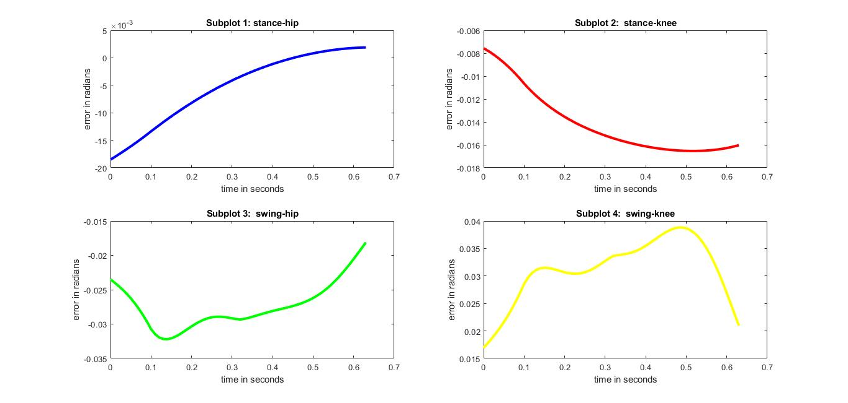
Error as a function of time - Fuzzy

Slide 19
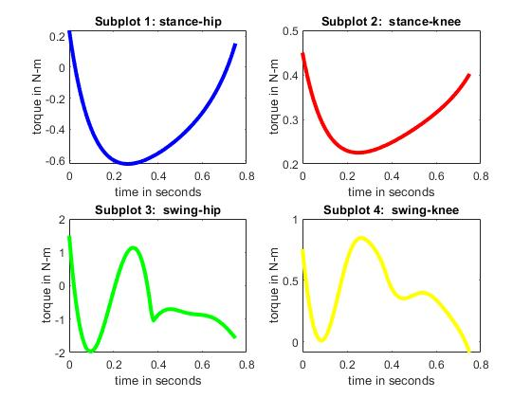
Actuator torques as function of time- Fuzzy

Slide 20
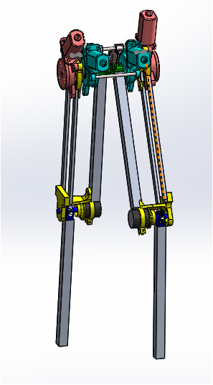
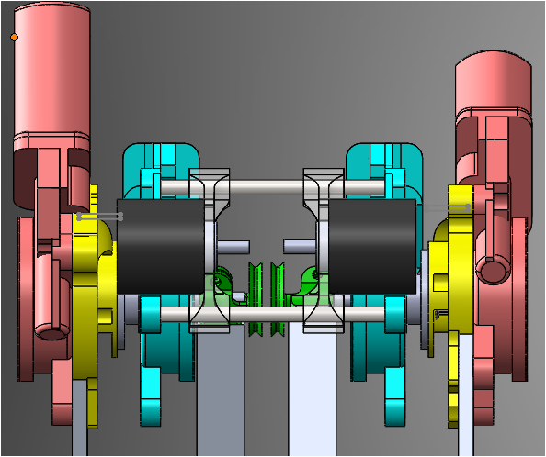
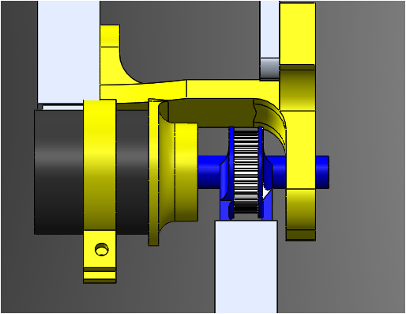
Mechanical Design and Manufacturing of robot
Biped CAD
Hip Joint
Knee Joint

Slide 21
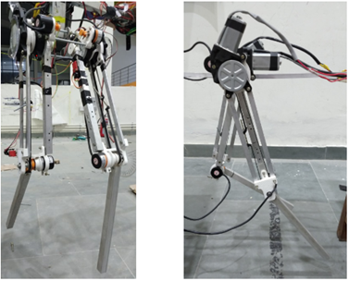
Mechanical Design and Manufacturing of robot
Biped Manufactured

Slide 22
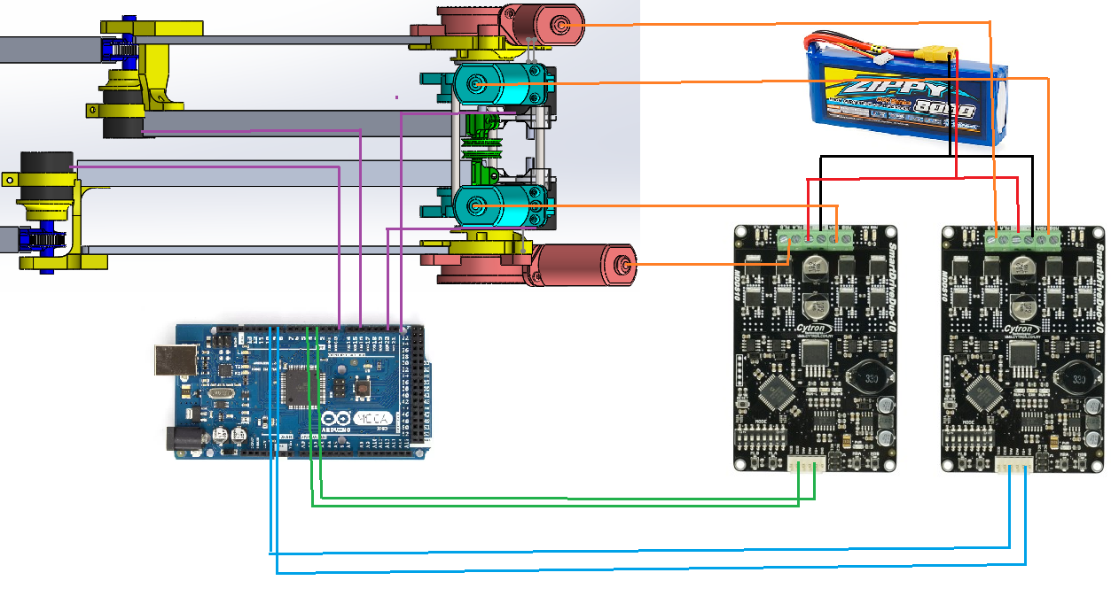
Electronic circuit design

Slide 23
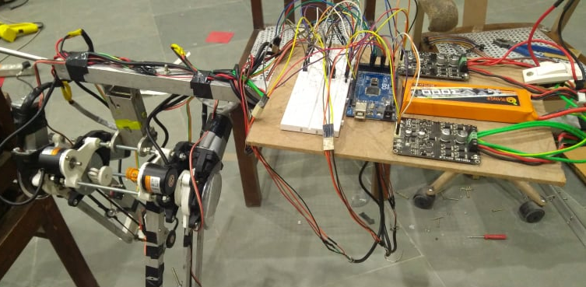
Electronics Design of Robot

Slide 24
Implementation of Controller
We used the robot dynamic model developed in first phase here.
We modelled the motor as well because the controller gave us the required torque value but the motors we are using is voltage control not torque controlled.

Slide 25
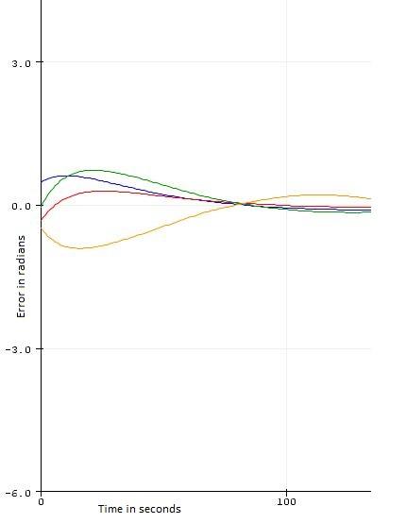
Results - Position Control

Slide 26
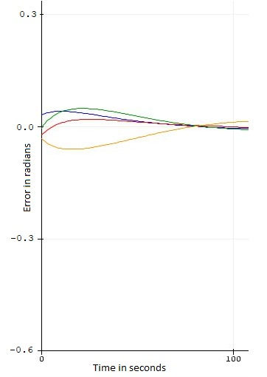
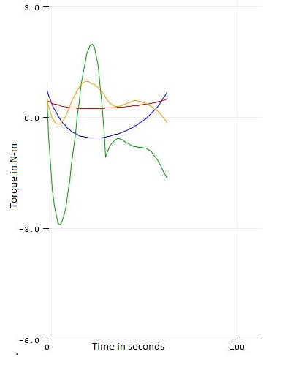
Results- Torque Control

Slide 27
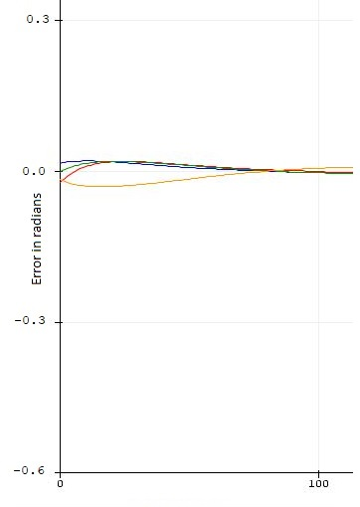
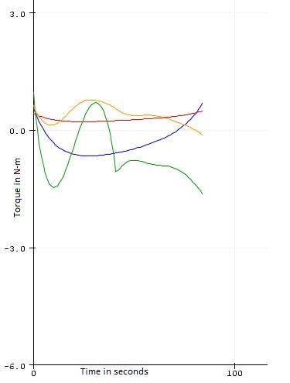
Results- Fuzzy Inference System

Slide 28


